Slide 1
Communication in the Workplace
Presented by
Noha Basilious
Diablo Valley College

Slide 2
Objectives
Define Communication.
Goals of Communication
Tips of Effective Communication
To be able to identify communication styles

Slide 3
What is Communication?
Notes:
This is another option for an overview using transitions to advance through several slides.

Slide 4
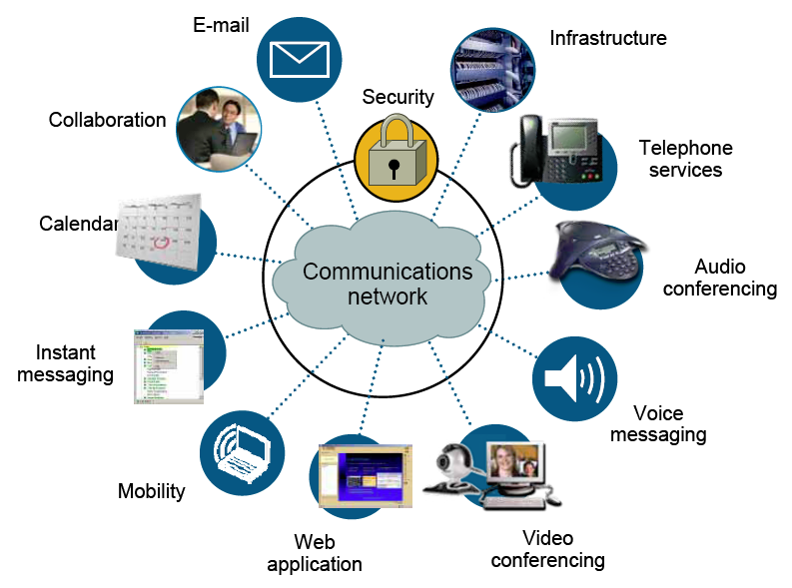
Ways of Communication
Notes:
This is another option for an overview using transitions to advance through several slides.

Slide 5
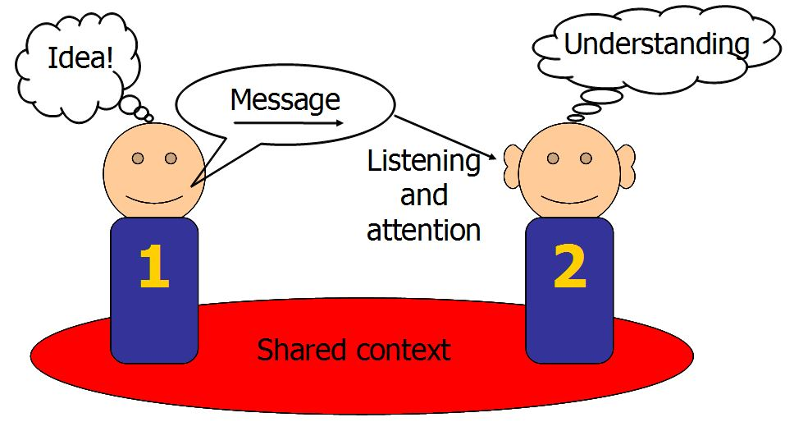
Communication
Communication is a key part of success in the workplace.
Without communication skills we are unable to let others know what we think, feel, or want to accomplish.
Without communication skills we are unable to build partnerships, motivate others, or resolve conflict.

Slide 6
Communication
Communication is the exchange of thoughts, messages, or information, as by speech, signals, writing, or behavior
Communication is the ART and Technique of using words effectively to import information or ideas.
Communication differs from one person to another and from one place to another, but many aspects are universal.

Slide 7
Communication

Slide 8
Communication

Slide 9
What are the Goals of Communication

Slide 10
Tips to Effective Communication
Active Listening
Encourage
When you list to others attentively it encourages them feel good.
In turns, you form an understating and respect and they will listen to you when its your turn to speak.
Restate
To show the person that you were paying attention, restate what they said in your own words.
Question
Ask questions to avoid any misunderstanding
Notes:
This is another option for an overview using transitions to advance through several slides.

Slide 11
Activity Time
Listen
Time to see how good a listener you are!
Notes:
This is another option for an overview using transitions to advance through several slides.

Slide 12
Tips to Effective Communication
Speak Clearly
Take a deep breath and remain positive when talking to people
Try to cut the “ums”, “uh-humms”, and “ahhs” as these make it difficult for people to understand what you’re trying to communicate.
Try to keep your voice steady and don’t talk too quickly or too quietly.
Be confident in what you are saying and others will feel your confidence too
Notes:
This is another option for an overview using transitions to advance through several slides.

Slide 13
Tips to Effective Communication
Be Genuine
Speaking honestly, expressing excitement or sadness when you feel like it and being friendly.
There is nothing wrong with saying “no, I don’t’ really agree with that” or “you know, I think you’ve changed my mind” however DON’T be rude.
Being honest builds your confidence and strengthen your connection with people.
Notes:
This is another option for an overview using transitions to advance through several slides.

Slide 14
Tips to Effective Communication
Be Receptive
Be open to what others are saying and offering
Often people restrict the flow of ideas or communication because they’re making too many assumptions or are being too quick to judge and criticize
Notes:
This is another option for an overview using transitions to advance through several slides.

Slide 15
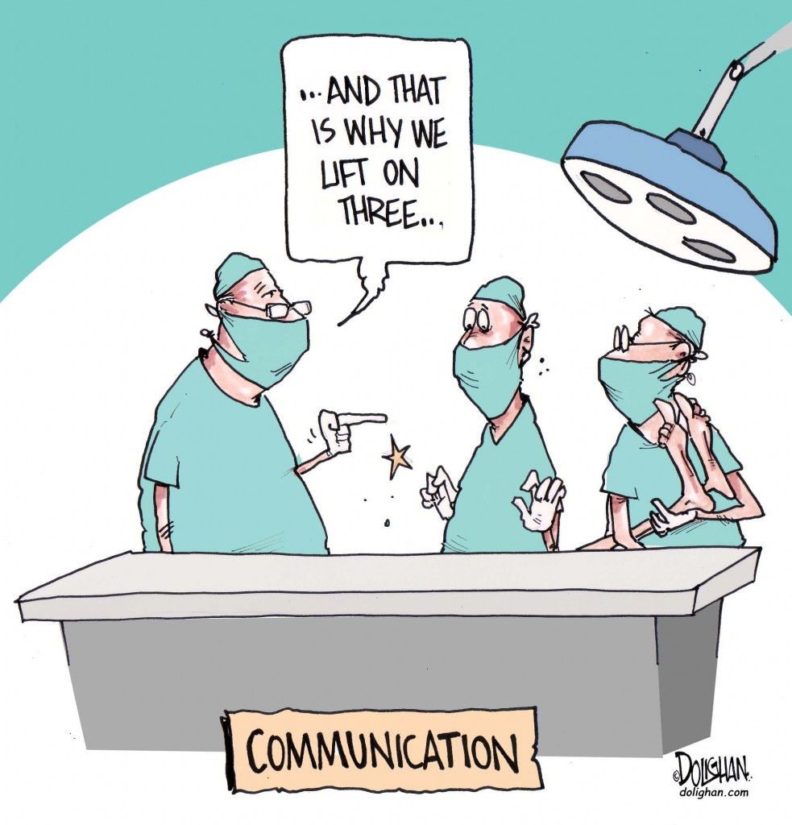
Activity
Communication
Time to see how good a Communicator you are!
Notes:
This is another option for an overview using transitions to advance through several slides.

Slide 16
Tips to Effective Communication
Familiarize yourself with the communication styles tools.
Controller/Director
Promoter/Socializer
Supporter/Relater
Analyzer/Thinker
Notes:
This is another option for an overview using transitions to advance through several slides.

Slide 17
FUN FUN FUN
Now time for FUN activities
Notes:
This is another option for an overview using transitions to advance through several slides.

